Slide 1

Tracking and Analyzing the Evolution of Provenance from Scripts
João Felipe Nicolaci Pimentel (UFF), Juliana Freire (NYU), Vanessa Braganholo (UFF), Leonardo Murta (UFF)

Slide 2
Motivation

Slide 3
Life Cycle of Script Experiments
Execution
Analysis
Composition
Notes:
The life cycle of experiments is composed of 3 main phases: composition, execution and analysis.

Slide 4
Life Cycle of Script Experiments
Execution
Analysis
Composition
New scripts & input data
Notes:
During the composition phase, scientists formulate new hypotheses, prepare input data and code scripts

Slide 5
Life Cycle of Script Experiments
Execution
Analysis
Composition
New scripts & input data
New output data &
Provenance
Notes:
During the execution phase, scientists execute the scripts, obtaining its output data, and ideally its provenance

Slide 6
Life Cycle of Script Experiments
Execution
Analysis
Composition
New scripts & input data
New knowledge
New output data &
Provenance
Notes:
Finally, during the analysis phase, scientists analyze the results, obtaining new knowledge.

Slide 7
Trial and Error
Execution
Analysis
Composition
New scripts & input data
New knowledge
New output data &
Provenance
Notes:
Usually, the knowledge obtained by 1 iteration of this cycle is not enough for the experiment.
But it can be enough to reformulate the hypothesis and/or the scripts and repeat the cycle in a Trial and Error process
This will lead to new scripts, data and provenance

Slide 8
Evolution
Scripts evolve
Input and Output Data evolve
Provenance evolve
It might be necessary to go back to old versions
How can we support this scenario of evolution and provide provenance for scientists without imposing extra work?
Notes:
How can we support this scenario of evolution and provide provenance for scientists?

Slide 9
Evolution
Scripts evolve
Input and Output Data evolve
Provenance evolve
It might be necessary to go back to old versions
How can we support this scenario of evolution and provide provenance for scientists without imposing extra effort?
Notes:
How can we support this scenario of evolution and provide provenance for scientists without imposing extra work?

Slide 10
Provenance of Scripts
Require Changes
Transparent
YesWorkflow
McPhillips et al., 2015
API
Bochner; Gude; Schreiber, 2008
StarFlow
Angelino; Yamins; Seltzer, 2010
RDataTracker
Lerner and Boose, 2014
Sumatra
Davison, 2012
noWorkflow
Murta et al., 2014
LLVM compiler
Tariq et al., 2012
DataTracker
Stamatogiannakis et al., 2014
Fine-grained Coarse-grained
Notes:
In the last decade, many approaches have been proposed to capture provenance from scripts

Slide 11
Provenance of Scripts
Require Changes
Transparent
YesWorkflow
McPhillips et al., 2015
API
Bochner; Gude; Schreiber, 2008
StarFlow
Angelino; Yamins; Seltzer, 2010
RDataTracker
Lerner and Boose, 2014
Sumatra
Davison, 2012
noWorkflow
Murta et al., 2014
LLVM compiler
Tariq et al., 2012
DataTracker
Stamatogiannakis et al., 2014
Fine-grained Coarse-grained
Notes:
Some of them require users to change their scripts. Since they require an extra effort to specify what should be collect, they are not the focus of this work.

Slide 12
Provenance of Scripts
Require Changes
Transparent
YesWorkflow
McPhillips et al., 2015
API
Bochner; Gude; Schreiber, 2008
StarFlow
Angelino; Yamins; Seltzer, 2010
RDataTracker
Lerner and Boose, 2014
Sumatra
Davison, 2012
noWorkflow
Murta et al., 2014
LLVM compiler
Tariq et al., 2012
DataTracker
Stamatogiannakis et al., 2014
Fine-grained Coarse-grained
Notes:
Others are completely transparent, and the users just need to execute the scripts with the tool

Slide 13
Provenance of Scripts
Require Changes
Transparent
YesWorkflow
McPhillips et al., 2015
API
Bochner; Gude; Schreiber, 2008
StarFlow
Angelino; Yamins; Seltzer, 2010
RDataTracker
Lerner and Boose, 2014
Sumatra
Davison, 2012
noWorkflow
Murta et al., 2014
LLVM compiler
Tariq et al., 2012
DataTracker
Stamatogiannakis et al., 2014
Fine-grained Coarse-grained
Notes:
Among these transparent tools, the only one which can handle evolution of experiments is Sumatra, since it uses a version control system to collect script data before and after the execution.
However, Sumatra only captures provenance at coarse-grained granularity. So Sumatra is unable to collect intermediate file accesses and to answer questions about what happened during the execution.

Slide 14
Provenance of Scripts
Require Changes
Transparent
YesWorkflow
McPhillips et al., 2015
API
Bochner; Gude; Schreiber, 2008
StarFlow
Angelino; Yamins; Seltzer, 2010
RDataTracker
Lerner and Boose, 2014
Sumatra
Davison, 2012
noWorkflow
Murta et al., 2014
LLVM compiler
Tariq et al., 2012
DataTracker
Stamatogiannakis et al., 2014
Fine-grained Coarse-grained
Notes:
Ideally, we should be able to track fine-grained provenance evolution, but none of these approaches are able to do so.

Slide 15
Approach

Slide 16
Versioning
Evolution-aware provenance-capturing tool
Visualize and navigate on the evolution history
Compare trials
Fine-grained collection
Track intermediate files
Execution trace (optionally)
Notes:
Thus, we propose a provenance-capturing tool that is aware of evolution, supporting vizualization and navigation of the history, and comparison of trial provenance.
For our approach, we propose a version model broad enough to support fine-grained collection with intermediate files and execution traces

Slide 17
Proof of concept
Require Changes
Transparent
YesWorkflow
McPhillips et al., 2015
API
Bochner; Gude; Schreiber, 2008
StarFlow
Angelino; Yamins; Seltzer, 2010
RDataTracker
Lerner and Boose, 2014
Sumatra
Davison, 2012
noWorkflow
Murta et al., 2014
LLVM compiler
Tariq et al., 2012
DataTracker
Stamatogiannakis et al., 2014
Fine-grained Coarse-grained
Notes:
We implemented our approach as proof of concept on top of noWorkflow, which captures provenance from Python scripts

Slide 18
Guiding Example
Notes:
Now, I will present a guiding example with some situations that occur during the evolution of experiment and how our approach is able to help with them

Slide 19
Life Cycle of Experiments
Execution
Analysis
Composition
Notes:
In this example, we will follow the life cycle of experiments

Slide 20

New experiment!
Could you check if the precipitation of Rio de Janeiro remains constant across years?
@
Notes:
Let’s say the scientist receives a request from her collaborator asking to check if the precipitation of Rio de Janeiro remains constant across years.

Slide 21

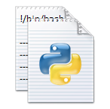

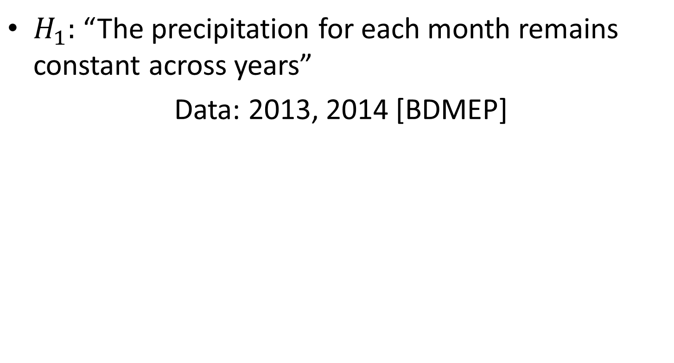
1st Iteration
$H_{1}:$ “The precipitation for each month remains constant across years”
Data: 2013, 2014 [BDMEP]
Project
experiment.py
precipitation.py
Execution
Analysis
Composition
p13.dat
p14.dat
Notes:
So, in the composition phase of the first iteration of the life cycle, she formulates the hypothesis “The precipitation for each month remains constant accross years”
To verify this hypothesis, she collects data from 2013 and 2014; uses the precipitation.py module; and codes the experiment.py script

Slide 22
1| import numpy as np
2| from precipitation import read, sum_by_month
3| from precipitation import create_bargraph
4|
5| months = np.arange(12) + 1
6|
7| d13, d14 = read("p13.dat"), read("p14.dat")
8|
9| prec13 = sum_by_month(d13, months)
10| prec14 = sum_by_month(d14, months)
11|
12| create_bargraph("out.png", months,
13| ["2013", "2014"],
14| prec13, prec14)
Execution
Analysis
Composition
Notes:
This script reads the input data from p13.dat and p14.dat on line 7
Then, it sums the precipation by month on lines 9 and 10
Finally, on line 12, it generates a bargraph on file out.png

Slide 23
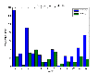
Trial
$ python experiment.py
Project
experiment.py
precipitation.py
p13.dat
p14.dat
Execution
Analysis
Composition
out.png
Notes:
During the execution phase, the scientist execute the script and collect the output for the analysis
Each execution of the script is called a trial

Slide 24
What happened during the execution?
@
Notes:
However, just executing the script and collecting the output is not enough.

Slide 25
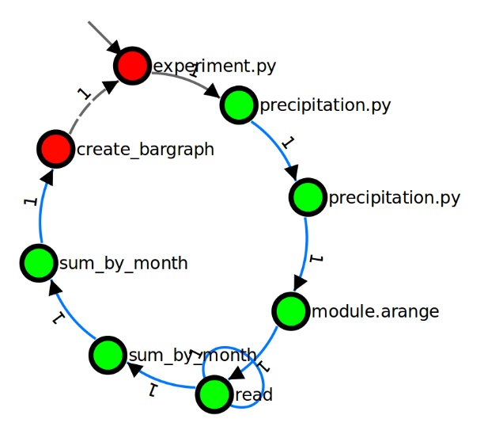
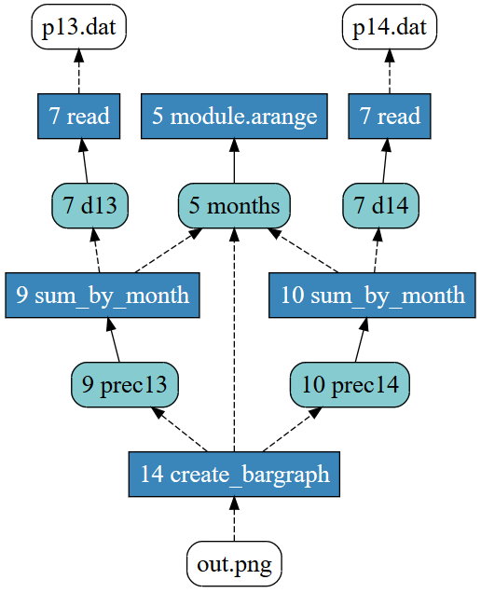
Provenance
$ now run -e Tracker experiment.py
Project
experiment.py
precipitation.py
p13.dat
p14.dat
Execution
Analysis
Composition
out.png
Notes:
The scientist could collect the experiment provenance as well.
At this moment, we start tracking the experiment history

Slide 26
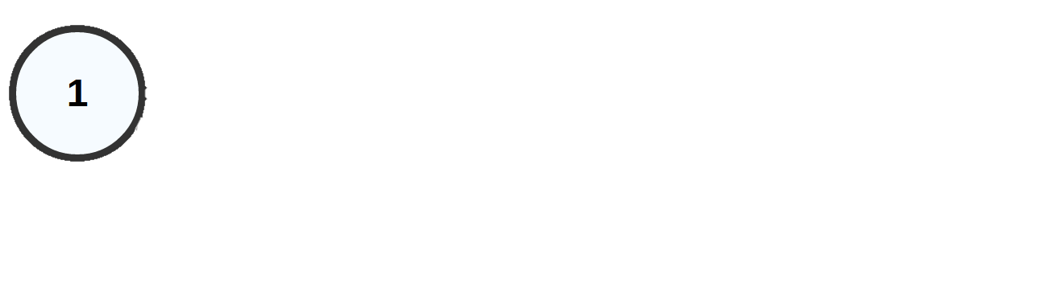
Version Model
Trial History
Product Space
Version Space
Experiment itself
script, data, prov. …
Trial Version
File Object Version
write
Project
Trial 1
read
experiment.py
1
precipitation.py
1
p13.dat
1
p14.dat
1
out.png
1
provenance
1
Notes:
To track the history, we defined a version model with a product space and a version space
The product space represents the experiment itself with the scripts, data and provenance
The version space represents versions of the experiment.
We have two types of versions: trial version and file object version.
A trial version represents the state of an execution as a whole.
And a file object version represents each file object access individually.
In this scenario, we have only one trial version, Trial 1, which is valid for the provenance as well
And we have many file object versions: one for each file

Slide 27
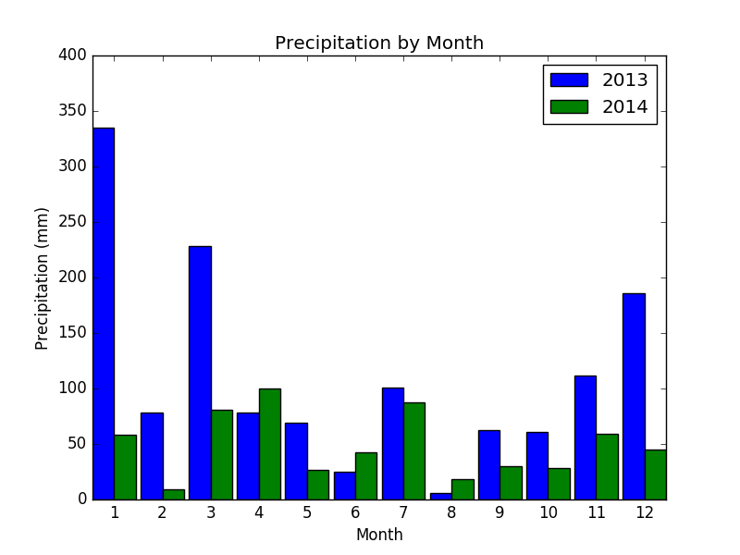
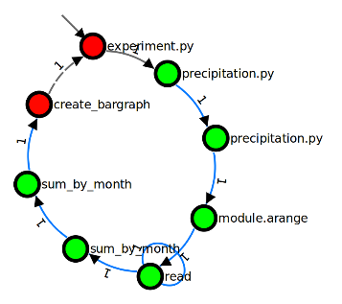
out.png
SELECT …
Execution
Analysis
Composition
Conclusion:
“Drought in 2014”
Notes:
After executing the script and collecting data and provenance, there comes the analysis phase
In this phase, the scientist run queries, look at the provenance, and visualize the results.
For this example, the scientist comes to a conclusion that there was a drought in 2014

Slide 28
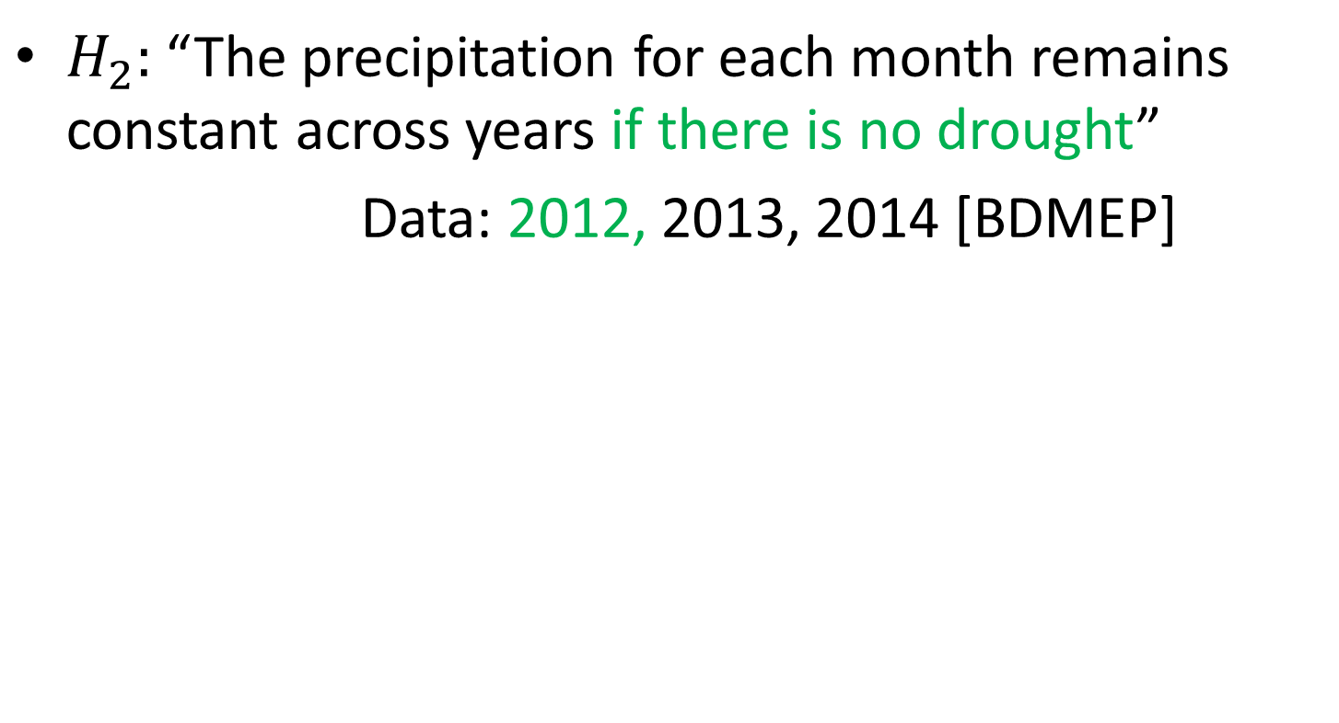
2nd Iteration
$H_{2}:$ “The precipitation for each month remains constant across years if there is no drought”
Data: 2012, 2013, 2014 [BDMEP]
Project
experiment.py
precipitation.py
Execution
Analysis
Composition
p12.dat
p13.dat
p14.dat
Notes:
So she uses this new knowledge to adapt the hypothesis: “The precipitation remains constant if there is no drought”
Then, she gets data from 2012, and change the experiment.py code to use it

Slide 29
1| import numpy as np
2| from precipitation import read, sum_by_month
3| from precipitation import create_bargraph
4|
5| months = np.arange(12) + 1
6| d12 = read("p12.dat")
7| d13, d14 = read("p13.dat"), read("p14.dat")
8| prec12 = sum_by_month(d12, months)
9| prec13 = sum_by_month(d13, months)
10| prec14 = sum_by_month(d14, months)
11|
12| create_bargraph("out.png", months,
13| ["2012", "2013", "2014"],
14| prec12, prec13, prec14)
Execution
Analysis
Composition
Notes:
In this script, the scientist added lines to read the new input file, process it, and create the bargraph with the result

Slide 30
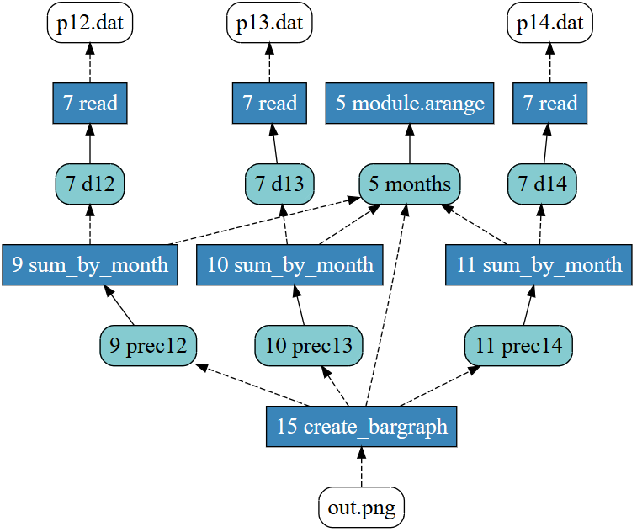
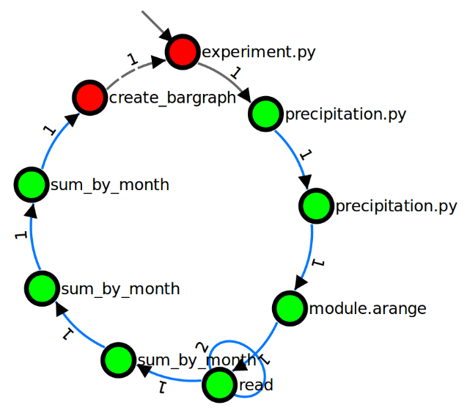
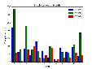
$ now run -e Tracker experiment.py
Project
experiment.py
precipitation.py
p12.dat
Execution
Analysis
Composition
p13.dat
p14.dat
out.png
João Felipe Nicolaci Pimentel
Notes:
After executing the script, it will generate a different out.png, and different provenance.

Slide 31
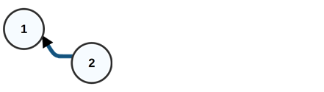
Version Model
Trial History
Product Space
Version Space
write
Project
Trial 1
Trial 2
read
experiment.py
1
2
precipitation.py
1
1
p12.dat
1
p13.dat
1
1
p14.dat
1
1
out.png
2
1
provenance
1
2
Notes:
After executing the script, we create a new Trial version: trial 2.
We use trial version to keep track of the evolution history. So, we can say that trial 2 were based on trial 1, since it executed after
Regarding file objects, this trial uses the same file object versions for precipitation.py, p13.dat, p14.dat, but it defines new version for experiment.py, out.png, which are different in this trial; and p12.dat, which is new

Slide 32
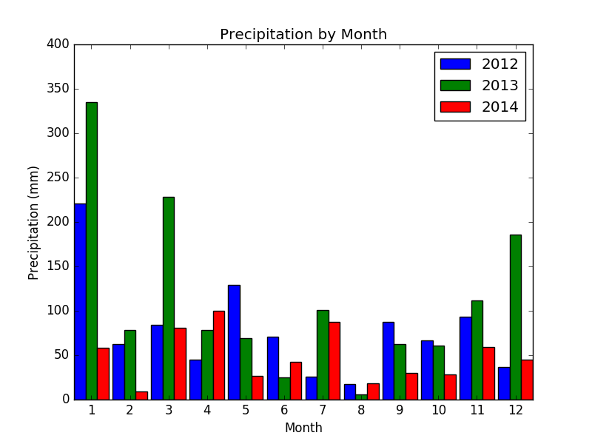
out.png
Execution
Analysis
Composition
Conclusion:
“2012 was similar to 2013”
Notes:
Now, in the analysis phase, the scientist comes to the conclusion that “2012 was similar to 2013”

Slide 33
What were the differences between Trial 1 and Trial 2?
@
Notes:
At this moment, the collaborator who didn’t participate in the second iteration decides to ask what are the difference

Slide 34
Comparing Trials
Trial History
Product Space
Version Space
addition
change
Project
Trial 1
Trial 2
removal
experiment.py
1
2
precipitation.py
1
1
p12.dat
1
p13.dat
1
1
p14.dat
1
1
out.png
2
1
provenance
1
2
Notes:
And the scientist need to answer that she has changed experiment.py, added p12.dat, and generated a different out.png as result
Our approach is able to do that by comparing file object versions.

Slide 35
noWorkflow Diff
Notes:
We present this result by running now diff command on noWorkflow

Slide 36


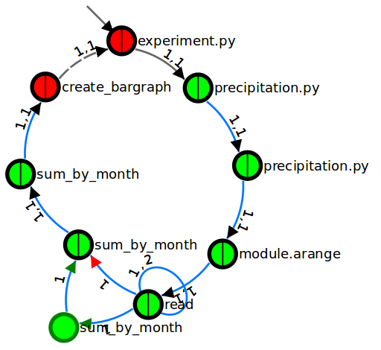
Activations Diff
Visualization tool: now vis
Trial 1
Trial 2
Diff
Notes:
Addionally, the scientist can also compare the activation graphs using the visualization tool

Slide 37
Notes:
And note that activations sum_by_month and read were added.

Slide 38
Notes:
And note that activations sum_by_month and read were added.

Slide 39
Notes:
And note that activations sum_by_month and read were added.

Slide 40
I don’t think its enough to compare just these years. Could you add data from 2015?
@
Notes:
After presenting the differences, the collaborator asks her to add data from 2015

Slide 41
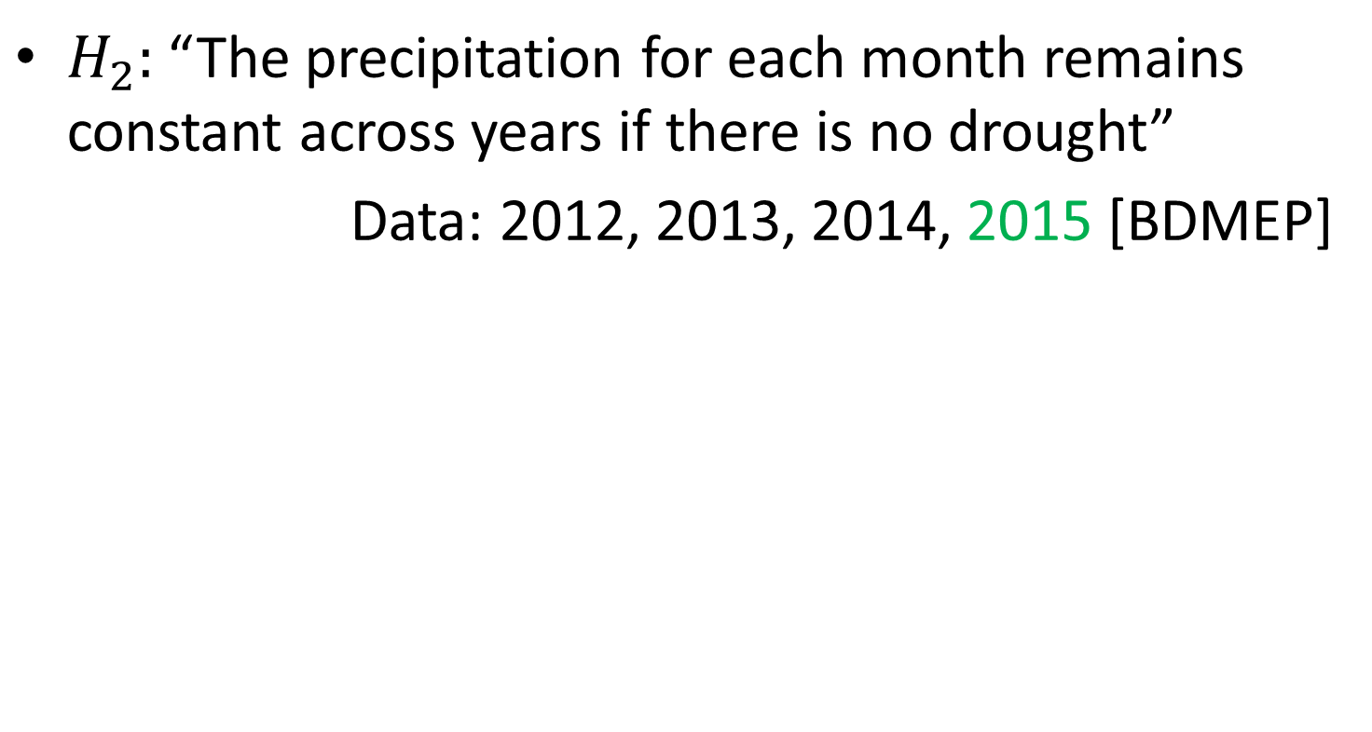
3rd Iteration
$H_{2}:$ “The precipitation for each month remains constant across years if there is no drought”
Data: 2012, 2013, 2014, 2015 [BDMEP]
Project
experiment.py
precipitation.py
Execution
Analysis
Composition
p12.dat
p13.dat
p14.dat
p15.dat
Notes:
So she uses this new knowledge to adapt the hypothesis: “The precipitation remains constant if there is no drought”
Then, she gets data from 2012...

Slide 42
1| import numpy as np
2| from precipitation import read, sum_by_month
3| from precipitation import create_bargraph
4|
5| months = np.arange(12) + 1
6| d12, d15 = read("p12.dat"), read("p15.dat")
7| d13, d14 = read("p13.dat"), read("p14.dat")
8| prec12 = sum_by_month(d12, months)
9| prec13 = sum_by_month(d13, months)
10| prec14 = sum_by_month(d14, months)
11| prec15 = sum_by_month(d15, months)
12| create_bargraph("out.png", months,
13| ["2012", "2013", "2014", "2015"],
14| prec12, prec13, prec14, prec15)
Execution
Analysis
Composition
Notes:
... and change the experiment.py code to use it

Slide 43
In the meantime
Forget what I said. There are unusual rainy days. Could you repeat the first trial without them?
@
Notes:
In the meantime, she receives another email from her collaborator asking her to stop the current iteration and go back to trial 1

Slide 44
$ now restore 1
write
Project
Trial 1
Trial 2
read
experiment.py
1
2
precipitation.py
1
1
p12.dat
1
p13.dat
1
1
p14.dat
1
1
out.png
2
1
provenance
1
2
Notes:
To do so, she can run “now restore 1” to restore trial 1.
This command restores the state of a trial before its execution. So, it restores file object versions of Trial.
Note that this command will remove out.png, because it didn’t exist before Trial 1 create it
But it won’t touch other files, such as p12.dat, because Trial 1 didn’t use it

Slide 45


What about the 3rd iteration?
3rd Iteration
!/bin/bash
----------
----------
----------
----------
Notes:
And it raises the questions: “what about the 3rd iteration? Will the scientist lose her changes?”

Slide 46
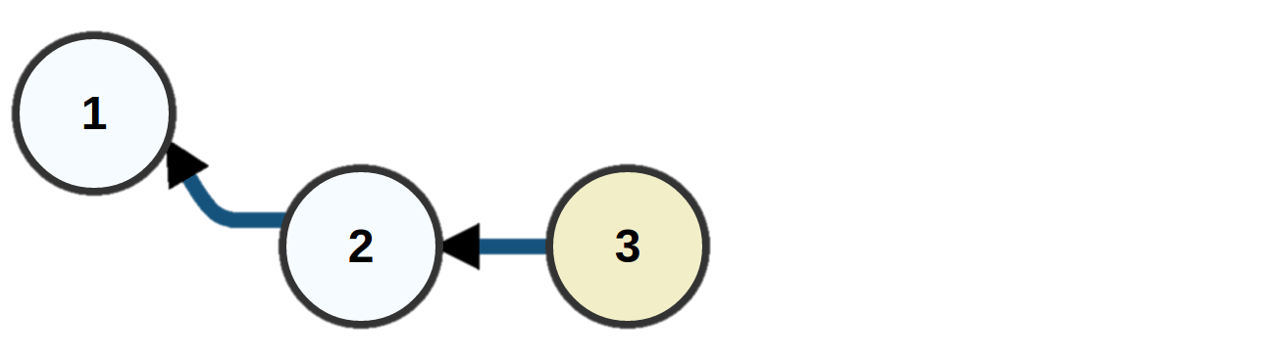
Backup Trial
Trial History
Product Space
Version Space
backup
write
Project
Trial 1
Trial 2
Trial 3
read
experiment.py
1
2
3
precipitation.py
1
1
1
p12.dat
1
1
p13.dat
1
1
1
p14.dat
1
1
1
out.png
2
1
2
provenance
1
2
Notes:
The answer is “no”! If we restore a trial after modifying files, we create a backup trial based on the last trial with all the changes
In this case, “experiment.py” has changed.
Backup trials do not have provenance, since they do not represent executions

Slide 47
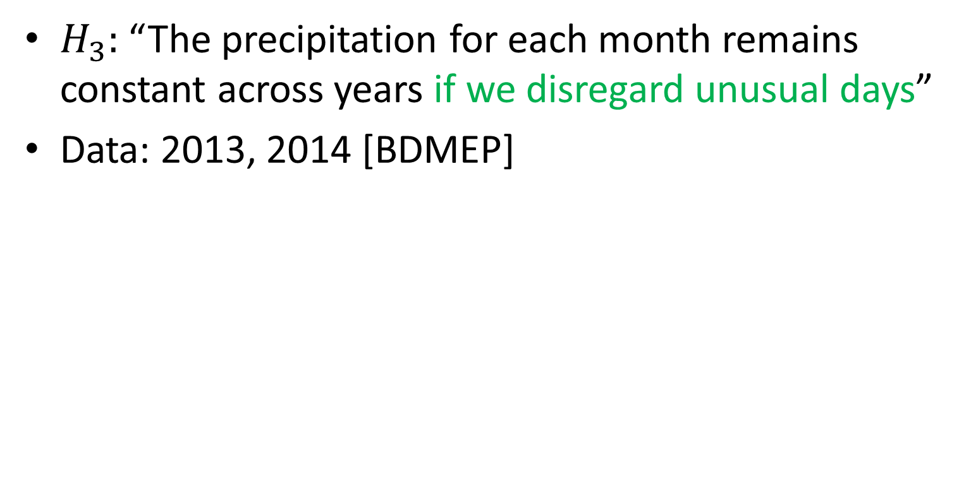
4th Iteration
$H_{3}:$ “The precipitation for each month remains constant across years if we disregard unusual days”
Data: 2013, 2014 [BDMEP]
Project
experiment.py
Execution
Analysis
Composition
precipitation.py
p13.dat
p14.dat
Notes:
Now, we are back on the composition phase of the 4th iteration.
The scientist reformulate the hypothesis. It becomes “the precipitation remains constant if we disregard unusual days”

Slide 48
1| import sys
5| from precipitation import write, remove_outliers
7| months = np.arange(12) + 1
9| d13, d14 = read("p13.dat"), read("p14.dat")
10|
11| for i in range(int(sys.argv[1])):
12| write("temp13.dat",remove_outliers(d13), 2013)
13| write("temp14.dat",remove_outliers(d14), 2014)
14| d13,d14=read("temp13.dat"), read("temp14.dat")
15|
16| prec13 = sum_by_month(d13, months)
17| prec14 = sum_by_month(d14, months)
19| create_bargraph("out.png", months,
20| ["2013", "2014"],
21| prec13, prec14)
Notes:
To disregard unusual days, she implements an iterative outlier detection and removal approach.
This approach receives the number of iterations as parameter.
For each iteration, it removes outliers from the dataset, and write new datasets to temporary files “temp13.dat” and “temp14.dat”
Then, it reads the data from the temporary files.

Slide 49
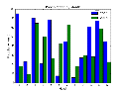
$ now run -e Tracker experiment.py 2
Project
experiment.py
precipitation.py
p12.dat
p13.dat
p14.dat
Execution
Analysis
Composition
out.png
temp13.dat
temp14.dat
João Felipe Nicolaci Pimentel
Notes:
After executing the script, it will generate out.png, temp13.dat, and temp14.dat

Slide 50
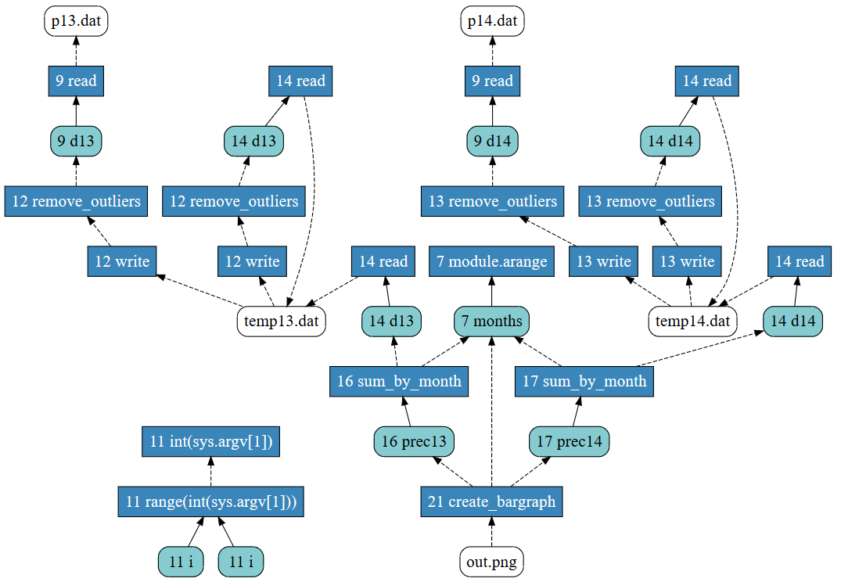
Execution
Analysis
Composition
Notes:
With a bit more complex provenance

Slide 51
Execution
Analysis
Composition
Notes:
Note that the temporary files were written twice before being read (also twice)

Slide 52
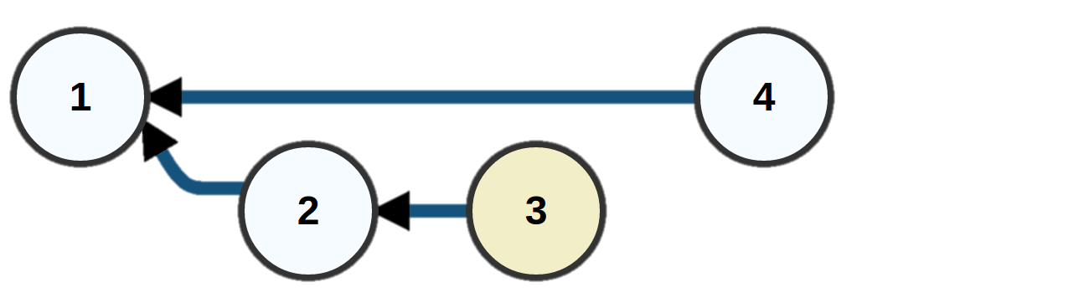
Trial History
backup
write
read
Project
Trial 1
Trial 2
Trial 3
Trial 4
experiment.py
1
2
3
4
precipitation.py
1
1
1
1
p12.dat
1
1
p13.dat
1
1
1
1
p14.dat
1
1
1
1
out.png
2
3
1
2
temp13.dat
1
1
2
2
temp14.dat
1
1
2
2
provenance
1
2
4
Notes:
Going back to our version model

Slide 53
Trial History
backup
write
read
Project
Trial 1
Trial 2
Trial 3
Trial 4
experiment.py
1
2
3
4
precipitation.py
1
1
1
1
p12.dat
1
1
p13.dat
1
1
1
1
p14.dat
1
1
1
1
out.png
2
3
1
2
temp13.dat
1
1
2
2
temp14.dat
1
1
2
2
provenance
1
2
4
Notes:
Our approach keeps track of all the access to these temporary files through file object versions.
In this case, there are two write accesses and two read accesses to temp13.dat on trial 4

Slide 54
Trial History
backup
write
read
Project
Trial 1
Trial 2
Trial 3
Trial 4
experiment.py
1
2
3
4
precipitation.py
1
1
1
1
p12.dat
1
1
p13.dat
1
1
1
1
p14.dat
1
1
1
1
out.png
2
3
1
2
temp13.dat
1
1
2
2
temp14.dat
1
1
2
2
provenance
1
2
4
Notes:
Our approach keeps track of all the access to these temporary files through file object versions.
In this case, there are two write accesses and two read accesses to temp13.dat on trial 4

Slide 55
Trial History
backup
write
read
Project
Trial 1
Trial 2
Trial 3
Trial 4
experiment.py
1
2
3
4
precipitation.py
1
1
1
1
p12.dat
1
1
p13.dat
1
1
1
1
p14.dat
1
1
1
1
out.png
2
3
1
2
temp13.dat
1
1
2
2
temp14.dat
1
1
2
2
provenance
1
2
4
Notes:
Observe now the history graph.

Slide 56
Notes:
Note that trial 4 was based on trial 1 because the scientist restored trial 1 before executing trial 4

Slide 57
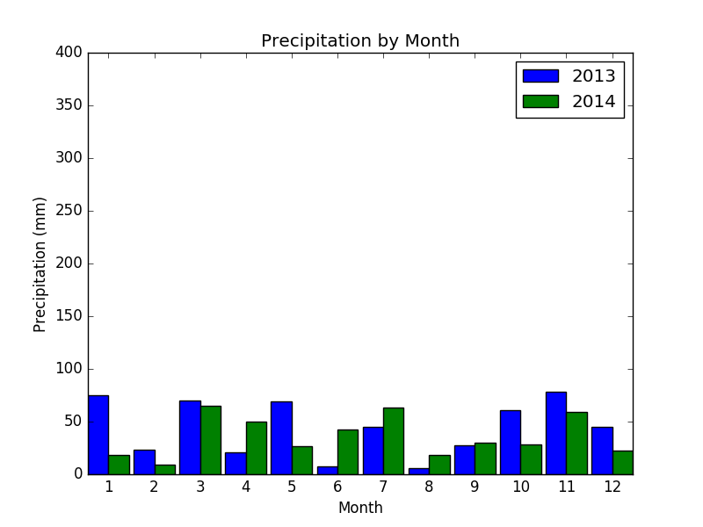
out.png – 2 iterations
Execution
Analysis
Composition
Notes:
Finally, it is time to analyze the results.

Slide 58
What would be the results if we had only one iteration of outlier removal? Could you compare to the result without removals (Trial 1)?
@
Notes:
For the analysis, the collaborator suggests comparing to results with just one iteration, and to results of trial 1.

Slide 59
Trial History
backup
write
read
Project
Trial 1
Trial 2
Trial 3
Trial 4
experiment.py
1
2
3
4
precipitation.py
1
1
1
1
p12.dat
1
1
p13.dat
1
1
1
1
p14.dat
1
1
1
1
out.png
2
3
1
2
temp13.dat
1
1
2
2
temp14.dat
1
1
2
2
provenance
1
2
4
Notes:
To do so, the scientist will need to restore out.png, and the processed temporary files from trial 4 after 1 iteration.

Slide 60
Trial History
backup
write
read
Project
Trial 1
Trial 2
Trial 3
Trial 4
experiment.py
1
2
3
4
precipitation.py
1
1
1
1
$ now restore 1 –f out.png
$ now restore 4 –f temp13.dat –i 1 –t p13.dat
$ now restore 4 –f temp14.dat –i 2 –t p14.dat
$ now run experiment.py 0
p12.dat
1
1
p13.dat
1
1
1
1
p14.dat
1
1
1
1
out.png
2
3
1
2
temp13.dat
1
1
2
2
temp14.dat
1
1
2
2
provenance
1
2
4
Notes:
The flag –f to now restore specifies which file should be restored
The flag –i specifies which access should be restored
Finally, the flag –t specifies the target file. In this case, temp13.dat is replacing p13.dat

Slide 61
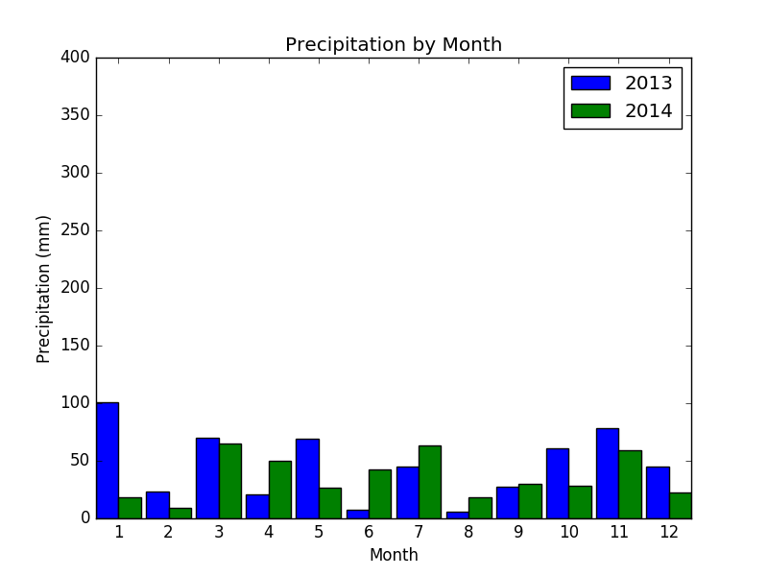
out.png – 2 iterations
out.png – 1 iteration
out.png – Trial 1
Execution
Analysis
Composition
Notes:
This way, it is possible to compare results of different trials and analyze intermediate results

Slide 62
Conclusion

Slide 63
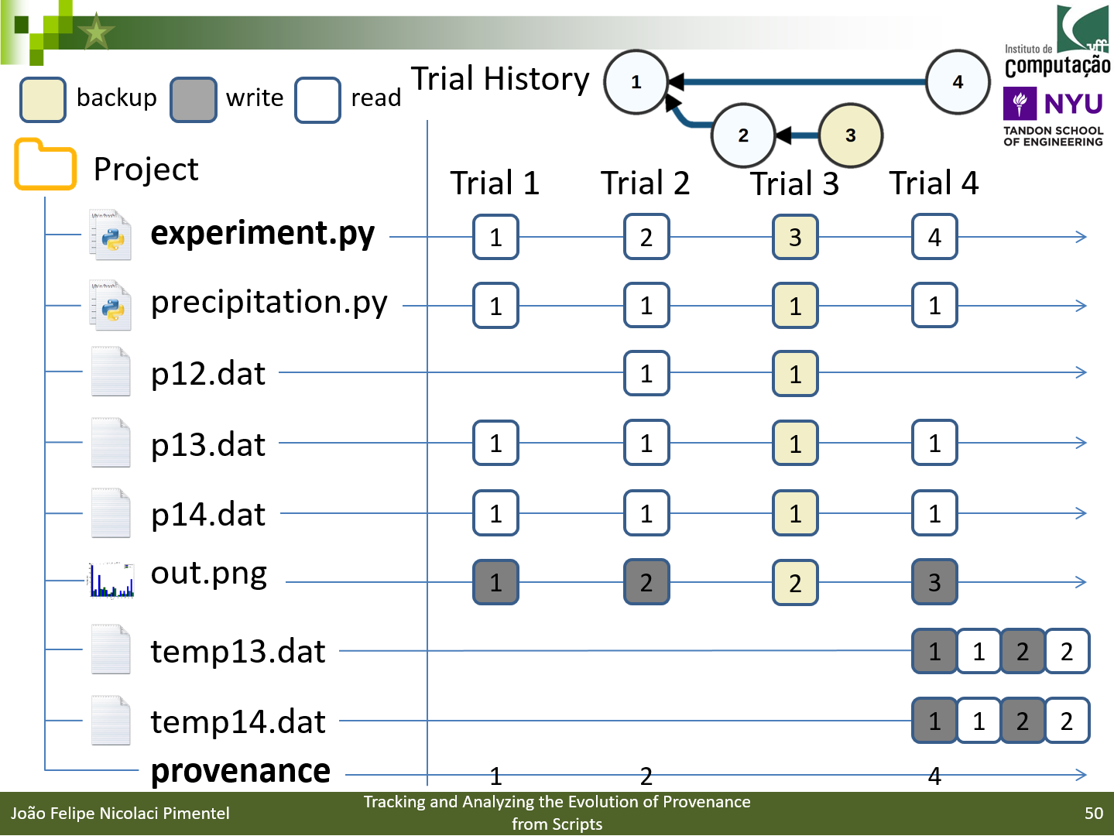
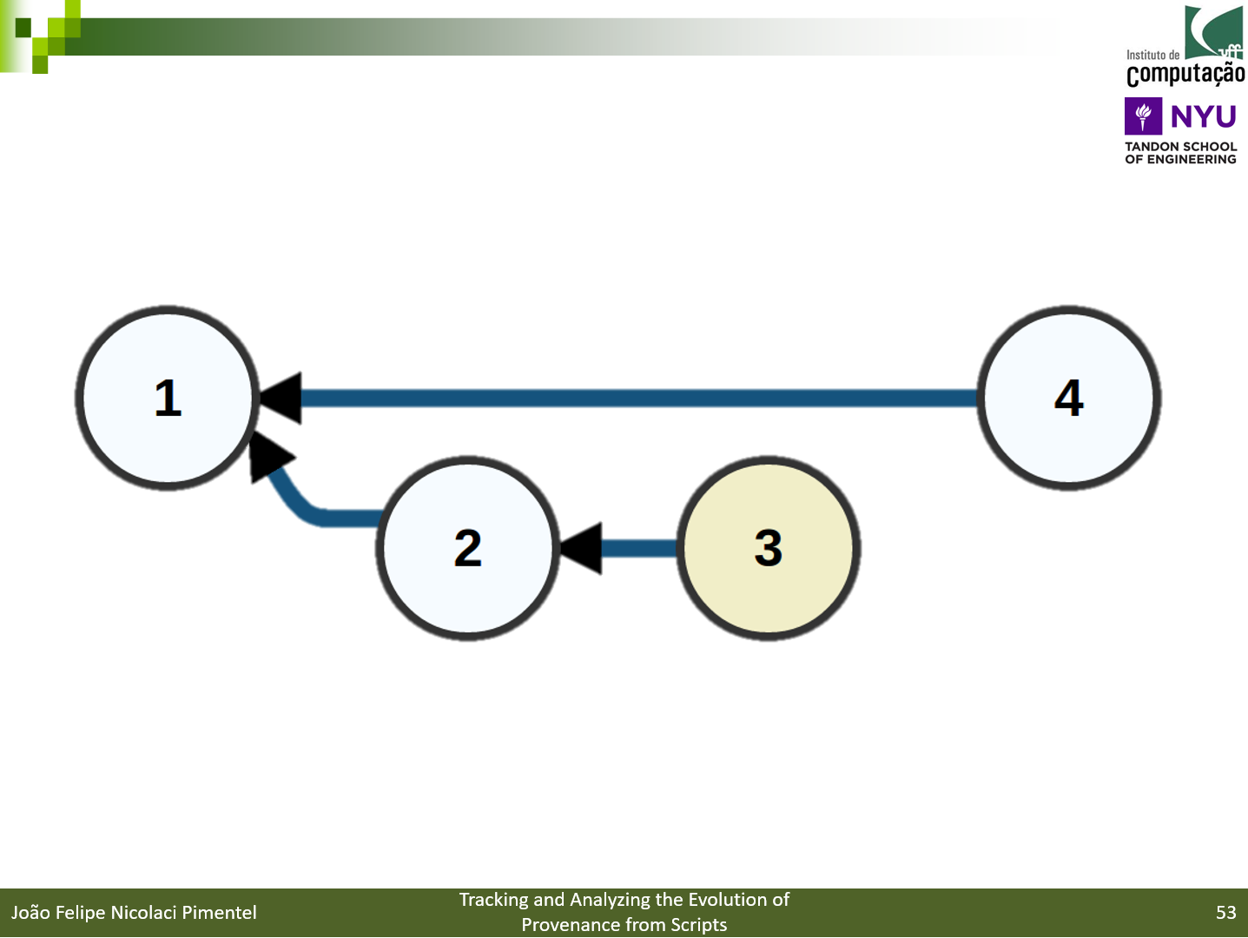
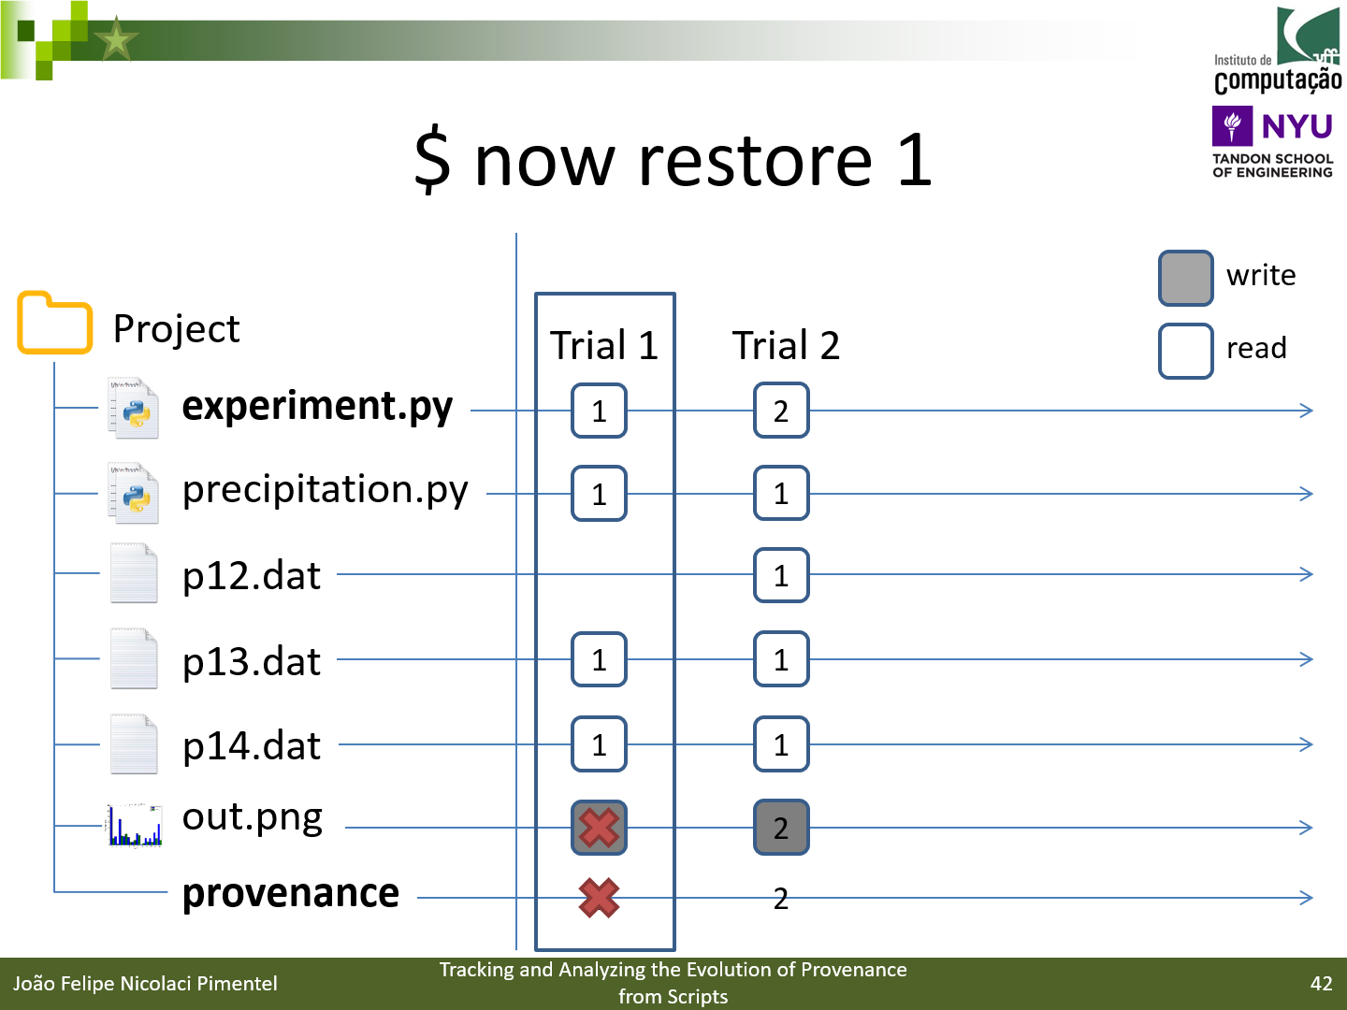
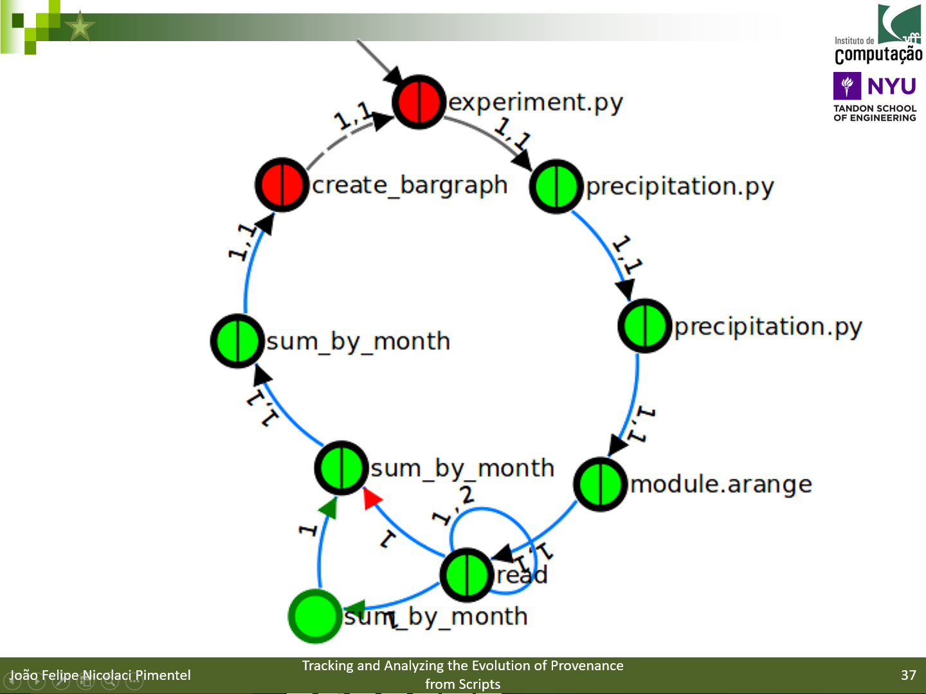
Notes:
In this presentation, we presented a novel approach with a version model that tracks the evolution of provenance from script.
With the proposed approach, it is possible to visualize and navigate on the history
In addition, it is possible to compare provenance and files from trials

Slide 64
Future Work
Optimization techniques
balance storage and re-computation costs
Alternatives on detecting file object changes
Semantic versioning for trials
Express intention of evolution
Improve activation graph matching and add other provenance comparison to noWorkflow
Notes:
As future work, we intend to work on opmization techniques, to balance storage and re-computation cost
We plan to work on alternative on detecting file object changes
We also intendo to apply semantic versiong for trials, to express the intention of evolution
Finally, we plan to improve activation graph matching and add other provenance comparison to noWor

Slide 65
Tracking and Analyzing the Evolution of Provenance from Scripts
jpimentel@ic.uff.br
https://github.com/gems-uff/noworkflow
João Felipe Nicolaci Pimentel (UFF), Juliana Freire (NYU), Vanessa Braganholo (UFF), Leonardo Murta (UFF)

Slide 66
Limitations
Overhead to collect all accesses
Implementation stores at fine-grain
Wasteful
Implementation restores only local modules

Slide 67
Related Work

Slide 68
Version Control System
Most approaches that capture provenance from scripts focus on a single trial
Scientists need to keep track of the experiment evolution by themselves
Version control systems
Coarse-grained provenance
files
May not handle provenance

Slide 69
Sumatra
Use version control systems to capture files before and after execution
Handle the evolution
Coarse-grained collection
Do not capture intermediate files

Slide 70
Evaluation

Slide 71
A set of 9 questions were obtained and adapted from the First Provenance Challenge (FPC) and ProvBench Workshops
We evaluate our work by answering them

Slide 72
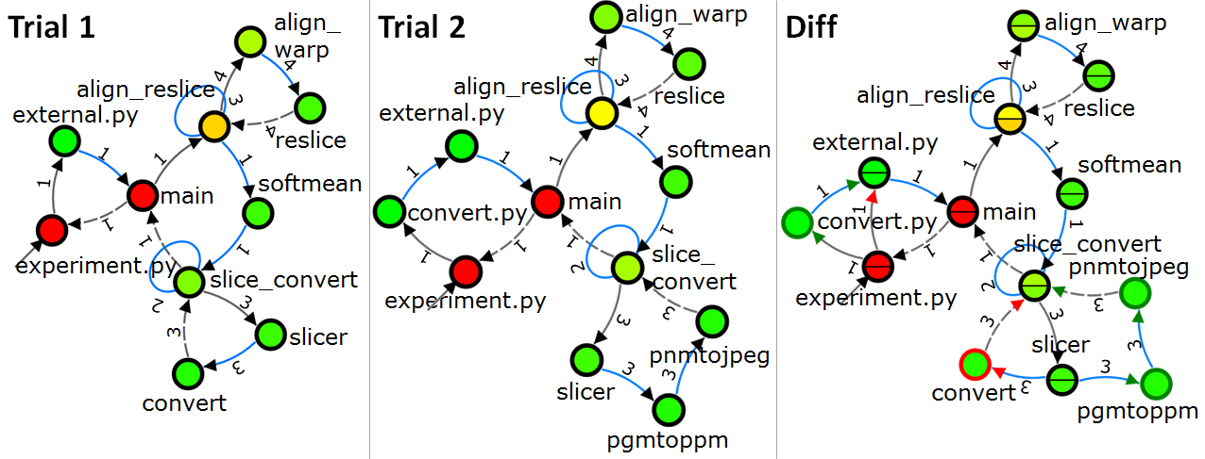
Q1: if a scientist has executed an experiment twice, but has replaced some procedures in the second trial, what are the trial differences? [FPC]
Q2: comparing multiple executions according to their parameters, what are the differences on execution behavior? [Swift-PROV]
Aa
a

Slide 73
Q3: how differences in the input data relate to differences in the values? [CSIRO-PROV]

Slide 74
Q4: using historical provenance, which parts of the execution fail frequently? [CSIRO-PROV]
SELECT name, count(name) AS c
FROM function_activation WHERE return_value = "-1“
GROUP BY name
ORDER BY c DESC;

Slide 75
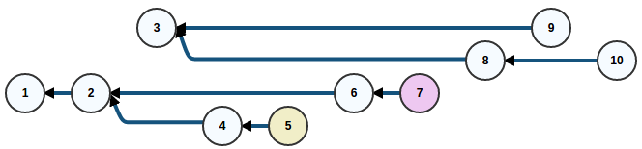
Q5: which trials are related to a given trial?
Q6. a given trial was derived from which trial? [VisTrails-PROV]
Q7. what are the available trials, and what are their durations?
Q8. how many trials are associated to a given source code?
Q9. how many trials present failures? [Wf4Ever-PROV]

